Slide 1
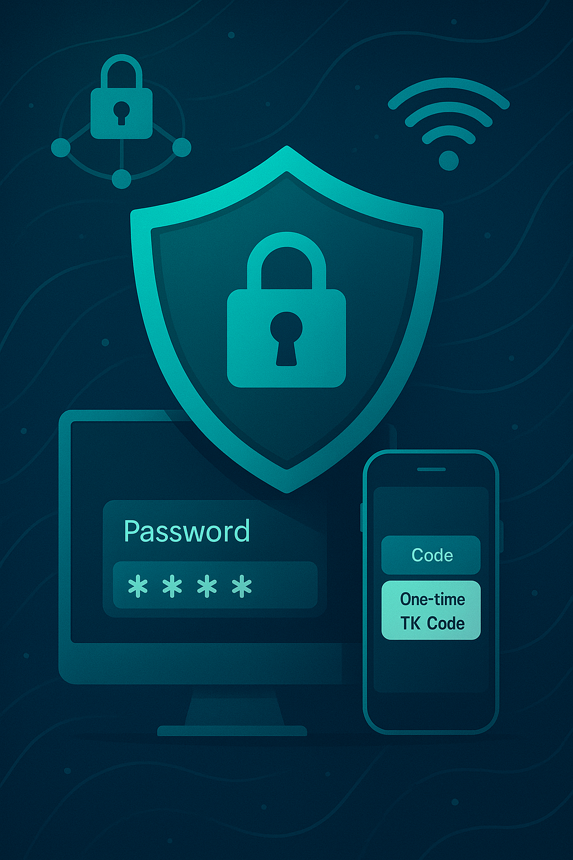
Multi-factor Authentication System
Group 8 :
Shreoshi Saharoy
Gorthi Lakshmi Sahitya
Anupama B S
Garapati Saranya

Slide 2

Introduction
In an era where digital threats are increasingly sophisticated, traditional password-based authentication is no longer
sufficient to safeguard user data.
Our Multi-Factor Authentication System is a secure web-based application enhancing login protection with hashed Passwords and One-Time verification codes via email or SMS.
This project highlights the real-world application of cryptography, and best authentication practices, providing a secure
and seamless login experience for end users.

Slide 3
Tools and Technologies
Backend
Frontend
Services
Python with Django
HTML5 and CSS3
SMTP for email delivery
PBKDF2 password hashing
JavaScript
Twilio API for SMS
AES with 256-bit key in CBC
Bootstrap v5.3
SQLite database

Slide 4
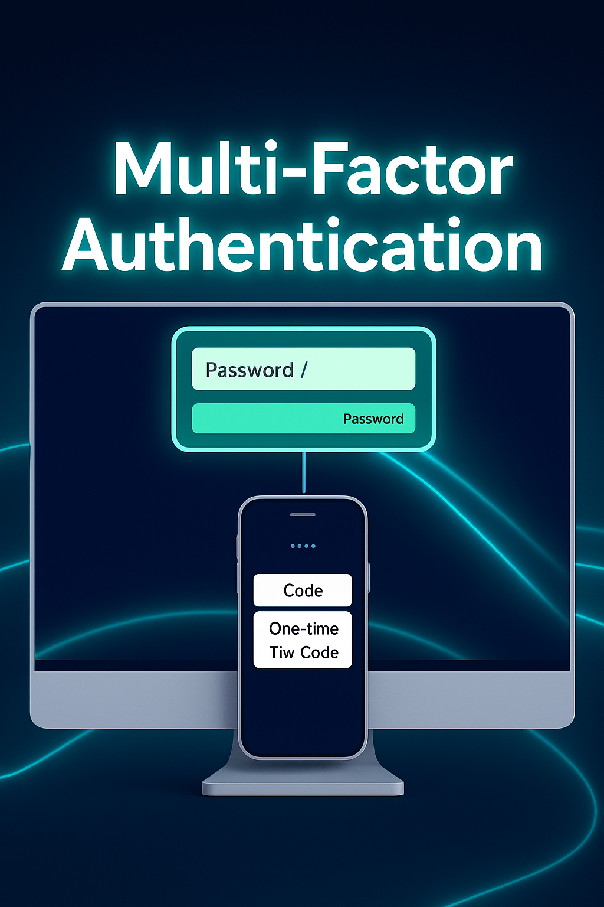




System Overview
Registration
Username, email, phone, password, OTP preference.
OTP secret is generated on successful registration.
Login
OTP is requested once credentials (username, password)
are verified.
OTP Verification
OTP is generated using user’s secure OTP secret.
Time-bound OTP (30 seconds validity) sent via email/SMS
Access Granted
Secure session established
Admin Monitoring
The admin/ Superuser panel can manage the users that are registered
and edit/delete their information as per requirement.

Slide 5
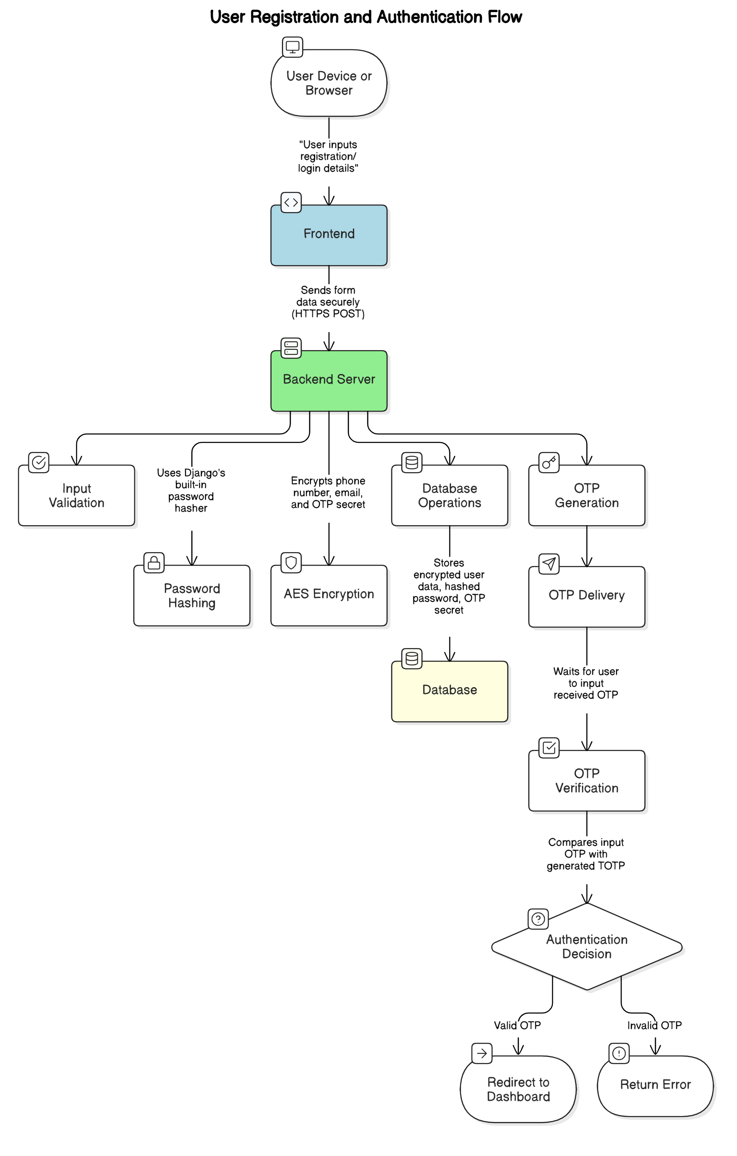
Architecture
Design

Slide 6







Implementation
Django Backend
Database (SQLite)
Django handles User registration & authentication
workflows; OTP generation and delivery;
Secure storage and retrieval of sensitive data;
Session management and access control.
It stores user records with fields
including: Username, Hashed password,
AES-encrypted email, phone number and
OTP secret key, OTP delivery preferences
(email or SMS).
2
OTP Generation
Encryption
The system uses the Python library ‘pyotp‘, which
adheres to the TOTP (Time-based OTP algorithm)
defined in RFC 6238. Each registered user is assigned
a unique OTP secret, a base32-encoded string securely
stored in the database.
Sensitive user information is encrypted using
AES before being saved to the database.
Python’s cryptography library is used for
Encryption and decryption.

Slide 7

Conclusion and Future Work
Security Achievements
Future Enhancements
AES encryption
Biometric integration
Password hashing
Push notifications
Time-based OTPs
Integrate with third party
authentication services
Conclusion
This project demonstrates secure web development practices & can be
extended to real world applications as it has :
Adaptable architecture
User privacy focus
Data integrity priority

Slide 8
THANK YOU!

